Slide 1
Homeowner’s Service Line Verification Informational Meeting
City and Township of Frankenmuth

Slide 2
Project Overview
In 2018 The Michigan Department of Environment, Great Lakes and Energy (EGLE) Revised the Lead and Copper Rule
  Create a Distribution System Materials Inventory (DSMI)
Create a list of services with unknown material installed before 1988.
  Service lines four or more inches in diameter are excluded from the verification list.
  A minimum number of unknown services are required to be physically verified.
  City – 1,579 unknown services, 310 services to be verified.
  Township – 175 unknown services, 35 services to be verified.
A random number generator was used to select the required locations for verification. The first 310 numbered locations were used in the City’s selection, the same process was used for the Township.

Slide 3
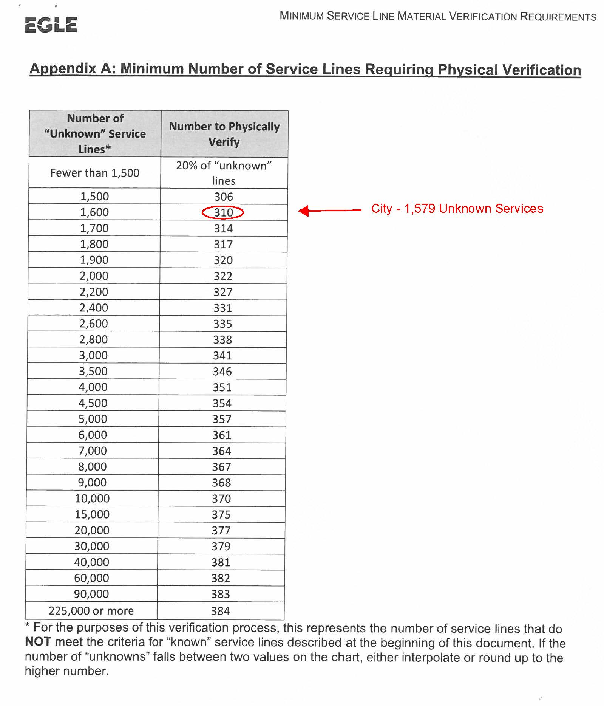

Slide 4
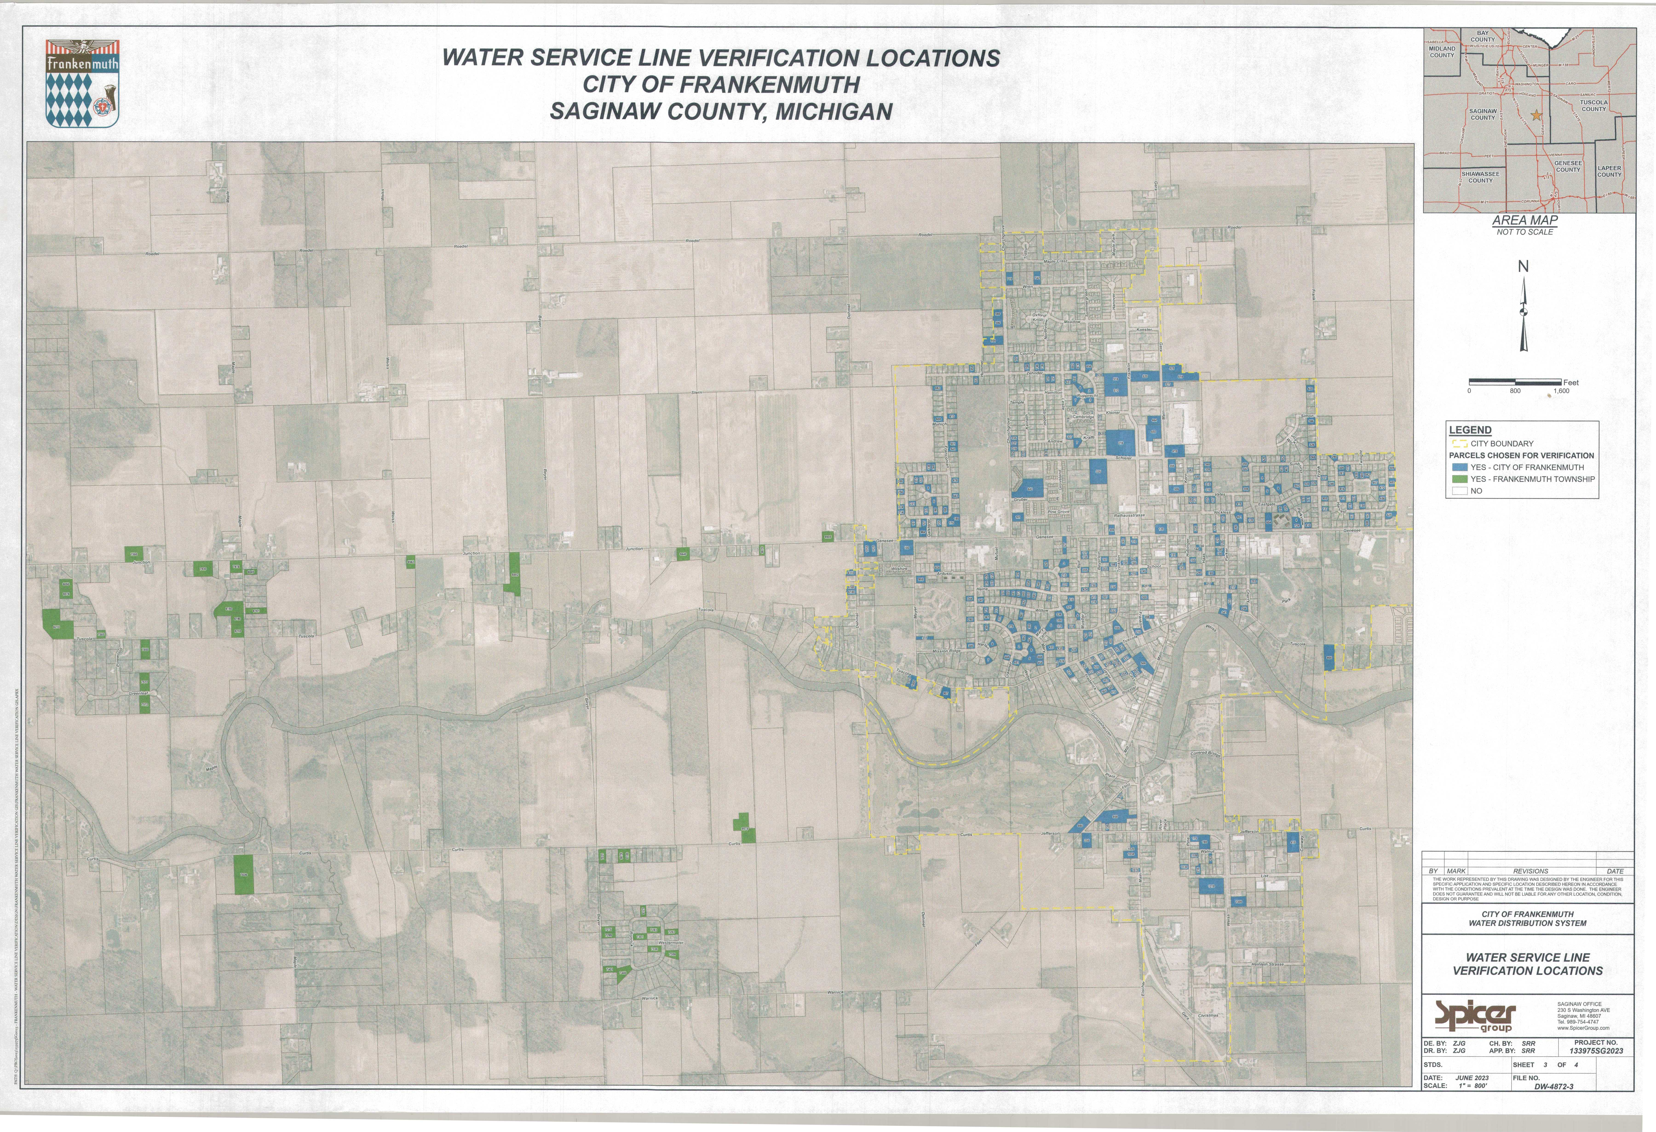
Site Locations for Verification

Slide 5
3 Points of Physical Verification Required
Water Main to Curb Stop (Point #1)
  Verify a minimum of 18 inches from the curb stop.
Curb Stop to Building (Point #2)
  Verify a minimum of 18 inches from the curb stop.
Inside the Home or Business (Point #3)
  Interior portion of the service line up to the first shut off valve or 18 inches inside the building, which ever is shorter.
  A Water Department employee will enter homes for this portion.
Note: Curb stops are typically located at the property line or 1 foot inside the sidewalk.

Slide 6
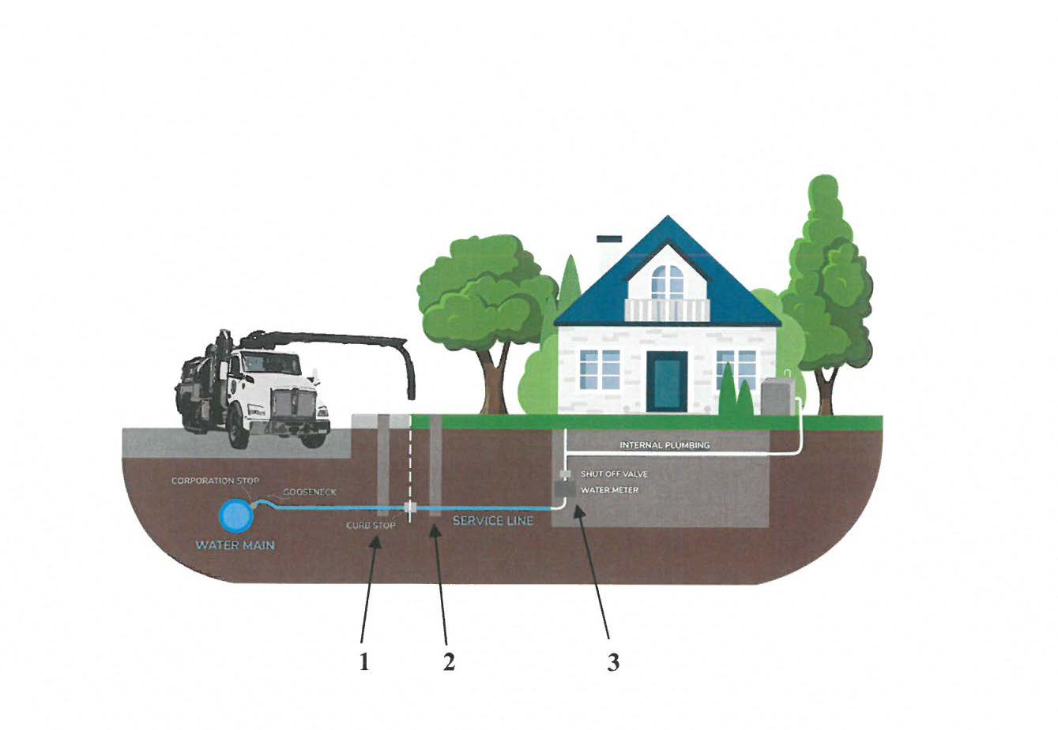
Hydro-Excavation
(Inside Verification)

Slide 7
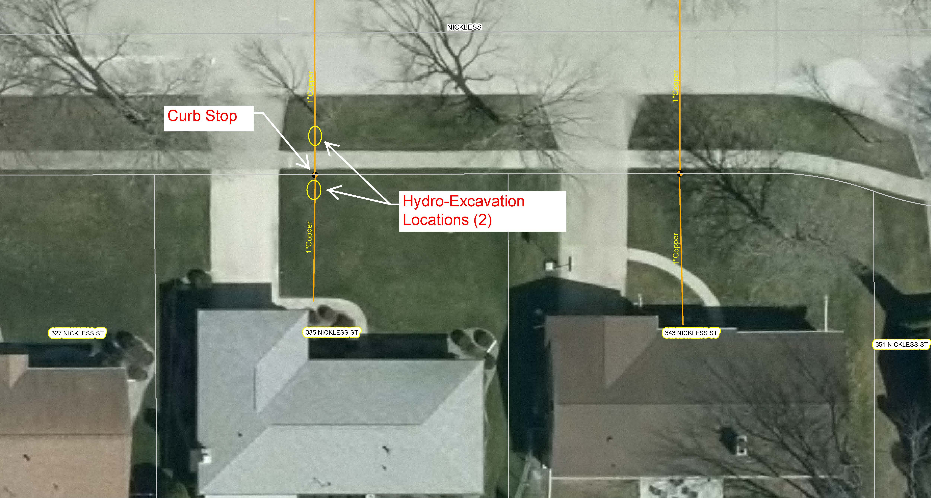
Hydro – Excavation Example

Slide 8
Tentative Start and Completion Dates
Start Date Tuesday, September 6, 2023
Substantial Completion Date November 18, 2023
Final Completion Date May 1, 2024

Slide 9
Potential Impact to Businesses/Homes
Project Working Hours Monday-Friday 7 AM to 4 PM
Traffic Control
Driveway Access/Driveway Reconstruction
Excavation Holes and Compaction
Black Dirt/Grass Seeding
Garbage and Mail Delivery

Slide 10
Questions/Concerns

